Slide 1

Machine Learning Project -Estimating 2nd hand Laptop Price
Presented By:
1. Rakesh Achanta(Team Lead)
2. Sailaja Velagala
3. Sri chakra Lakshmi
kollapureddy
4. Chandana Swarna Bala
Madhuri Pappu
5. Suseela Jerripothula
6. Keerthi reddy
7. Tharun Veluru

Slide 2

Business Objective, Understanding and Approach
Business Objective
Understanding
Business Objective
Understanding
A C2B firm is in the process of creating an online platform where the consumers can sell their used laptops. This platform should host an automated mechanism that can suggest to a consumer the realistic price of their used laptop when the required details (different features of the laptop) are provided.
A firm whose business nature is of the type consumer to business(C2B) wants to introduce an automated mechanism such that consumer who wants to sell their laptop has to fill the features of the laptop in order to get the reasonable price of their laptop.
Approach
Approach
The first step involves the cleaning of the given data which includes identifying missing values ,checking duplicate rows and dropping unnecessary columns.
The next step is data preprocessing which involves exploratory data analysis and feature engineering.
As the given dependent variable is a continuous variable, we are using decision tree regression algorithm.
If any overfitting occurs we need to prune the decision tree using hyperparameters and right set of hyperparameters can be achieved by using a method called GridsearchCV.

Slide 3
Analysis/ Modeling Methodology
Data Preparation & EDA
Variable Creation and Selection
Model Development
Model Performance Testing
Sub-setting of the data is done by removing Laptop_ID and Product features.
Bi-variate analysis conducted on all relevant features like Company, TypeName, Screenresolution, CPU, RAM, Memory, GPU and OS.
There are no missing values and duplicate records in the given data.
Touchscreen, IPS, PPI and SSD are the new features created as a part of feature engineering.
Dummy variables are created for the features Company, TypeName, Cpu_brand, Gpu_brand and OS by using pandas library.
Decision Tree Regression is choosen as the preferred modeling technique since for data with independent categorical variables, Decision Tree performs well than other algorithms like linear regression.
Observed 85% accuracy for the final model.
Conducted k-cross validation for k=10 and observed 81% of average cross validation score.
Mean Absolute error (MAE) of our final model is only about 1.19 .

Slide 4
Extended Data Dictionary (EDD)
 | Variable type | Min | Pc 1% | Pc 5% | Pc 25% | Pc 50% | Mean | Pc 75% | Pc 95% | Pc 99% | Max | % Missing values | % Unique values
Ram | int64 | 2.00 | 2.00 | 4.00 | 4.00 | 8.00 | 8.39 | 8.00 | 16.00 | 32.00 | 64.00 | - | 0.69
Weight | float64 | 0.69 | 0.97 | 1.17 | 1.50 | 2.04 | 2.01 | 2.30 | 3.20 | 3.50 | 3.50 | - | 13.13
Price_euros | float64 | 174.00 | 229.00 | 309.00 | 599.00 | 978.00 | 1124.04 | 1488.44 | 2448.80 | 3148.98 | 6099.00 | - | 60.75
Touchscreen | int64 | 0.00 | 0.00 | 0.00 | 0.00 | 0.00 | 0.15 | 0.00 | 1.00 | 1.00 | 1.00 | - | 0.15
IPS | int64 | 0.00 | 0.00 | 0.00 | 0.00 | 0.00 | 0.28 | 1.00 | 1.00 | 1.00 | 1.00 | - | 0.15
PPI | float64 | 90.58 | 100.45 | 100.45 | 127.34 | 141.21 | 146.57 | 157.35 | 210.00 | 210.00 | 210.00 | - | 1.99
SSD | int64 | 0.00 | 0.00 | 0.00 | 0.00 | 256.00 | 182.89 | 256.00 | 512.00 | 1000.00 | 1000.00 | - | 0.84
Key takeaways:
Outliers are observed in the features Weight and PPI and they are taken care of.
Average weight of a laptop is observed to be 2kg.
Average number of pixels observed per inch is around 146.

Slide 5
Feature Engineering – New variables created
S. No | Variable Name | Variable Type | Description
1 | Touchscreen | Numeric | A variable of values 0 and 1 to check whether the laptop has touchscreen or not.
2 | IPS | Numeric | A variable of values 0 and 1 to check whether the laptop has IPS display or not.
3 | PPI | Numeric | A continuous variable created by using screen resolution and inches of the laptop.
4 | Cpu_brand | Object | A discrete variable created to check CPU brand of the laptop.
5 | SSD | Numeric | A variable created to identify the amount of Solid State Drive memory of the laptop.
6 | Gpu_brand | Object | A discrete variable created to check GPU brand of the laptop.
7 | OS | Object | A discrete variable created to identify the Operating system of the laptop.

Slide 6
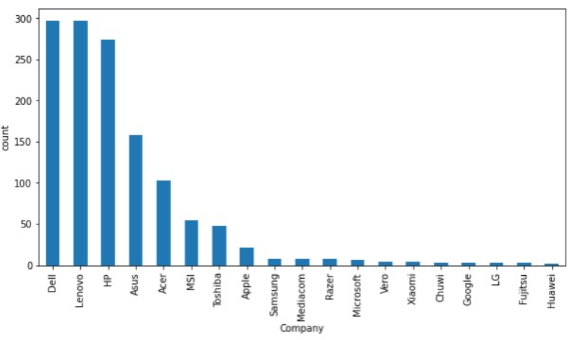
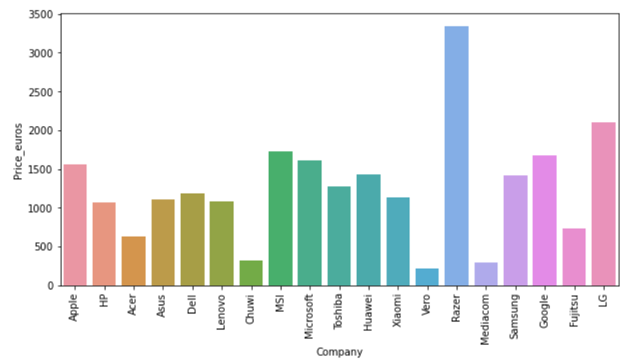
ANALYSIS RESULTS:
Analysis on Company variable
Key takeaways:
About 22% of the laptops in the given data are from each of the companies like Dell, Lenovo and HP.
There are very few number of laptops from the companies like Xioami, Google, LG etc.
Key takeaways:
Razer and LG are the high priced company laptops in the given data.
Vero, Mediacom and Chuwi are the least priced laptops in the given data.

Slide 7
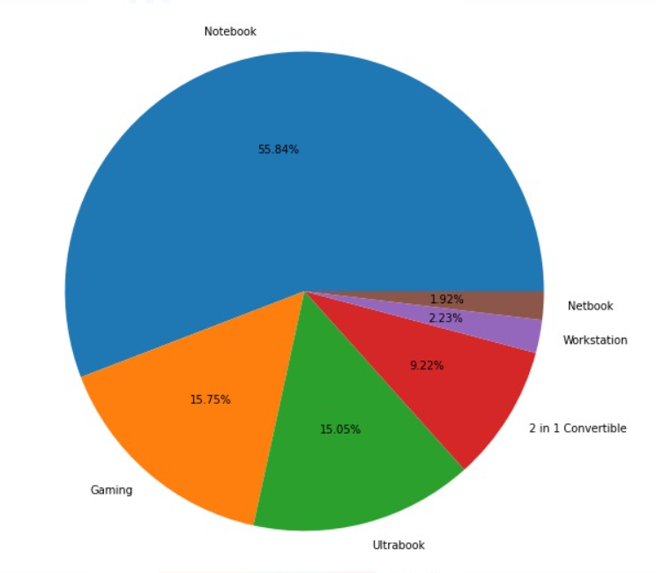
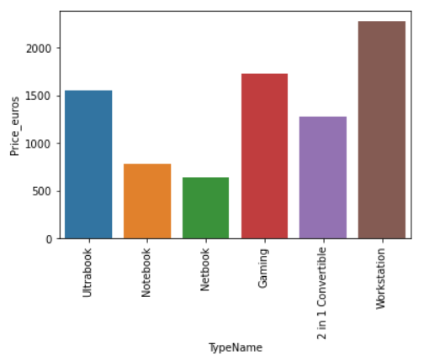
Analysis on Typename variable
Key takeaways:
About 55% of the laptops in the given data are of Notebook type.
Netbook and Workstation type laptops are least in number in the given data.
Key takeaways:
Workstation, Gaming and Ultrabook type laptops are of higher price.
Netbook and Notebook type laptops are of lower price.

Slide 8
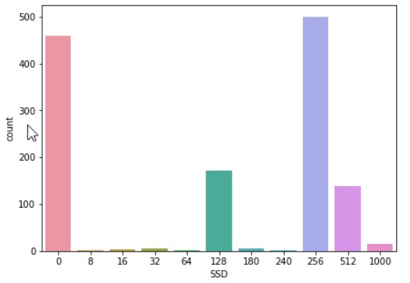
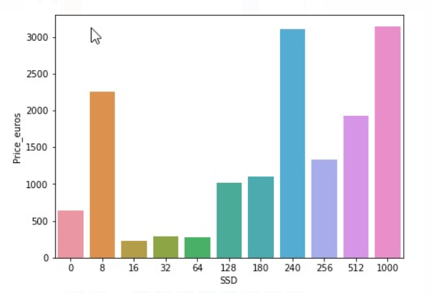
Analysis on SSD variable
Key takeaways:
About 38% of the laptops did not have SSD memory.
About 35% of the laptops have 256GB SSD memory.
Key takeaways:
Laptops with 1TB or 240GB SSD storage are the high priced laptops in the given data.
Laptops with 16GB, 32GB or 64GB SSD storage are the least priced laptops in the given data.

Slide 9
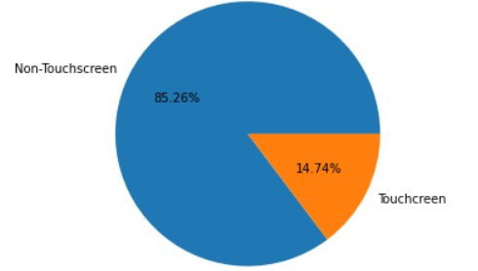
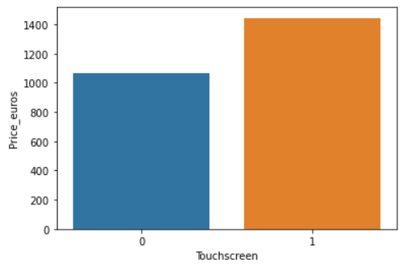
Analysis on Touchscreen variable
Key takeaways:
About 85% of the laptops in the data did not have touch screen.
About 15% of the laptops in the data has touch screen.
Key takeaways:
Laptops with touch screen are slightly more priced than the laptops without touchscreen.

Slide 10
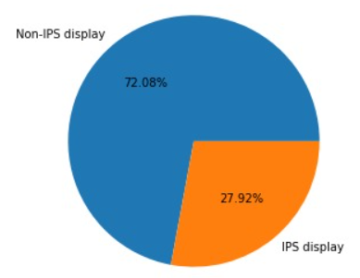
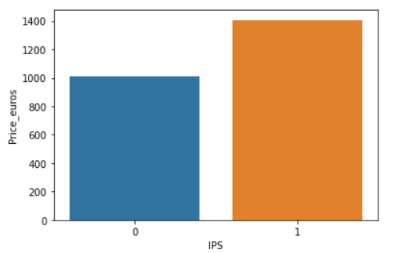
Analysis on IPS variable
Key takeaways:
About 72% of the laptops in the given data did not have IPS display.
About 27% of the laptops in the given data has IPS display.
Key takeaways:
Laptops with IPS display are slightly high priced than the laptops without IPS display.

Slide 11
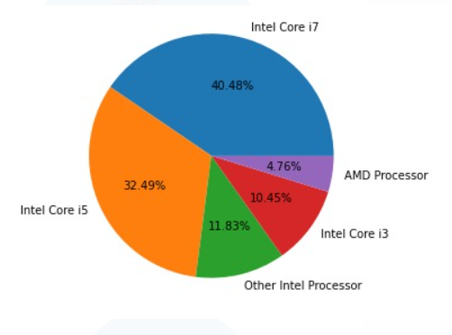
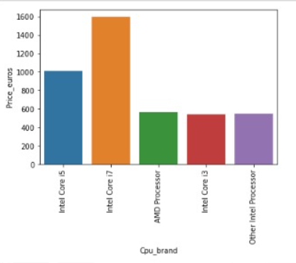
Analysis on CPU brand variable
Key takeaways:
About 40% of the laptops in the data has Intel Core i7 processor.
About 32% of the laptops in the data has Intel core i5 processor.
Only 4% of the laptops in the data has AMD processor.
Key takeaways:
Laptops with Intel core i7 processor are the high priced laptops.
Laptops with AMD, Intel core i3 and Other intel processor are similar and least priced laptops.

Slide 12
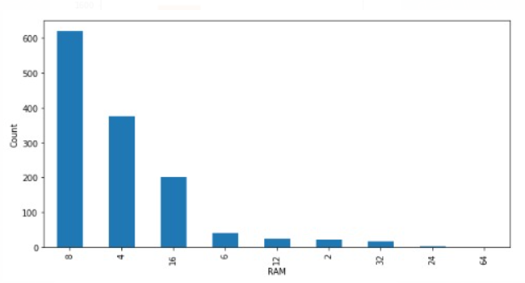
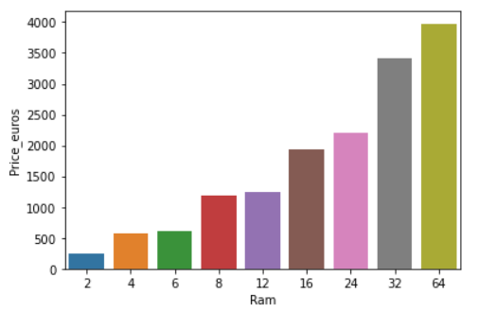
Analysis on RAM variable
Key takeaways:
About 47% of the laptops in the given data consists of 8GB RAM.
About 28% of the laptops in the given data consists of 4GB RAM.
About 15% of the laptops in the given data consists of 16GB RAM.
Laptops with other RAM’s are very low in the given data.
Key takeaways:
Laptops with 64GB and 32GB RAM are high priced laptops.
Laptops with 2GB, 4GB and 6GB RAM are low priced laptops.
Price of the laptop increases with increase in RAM.

Slide 13
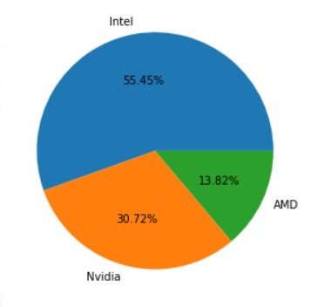
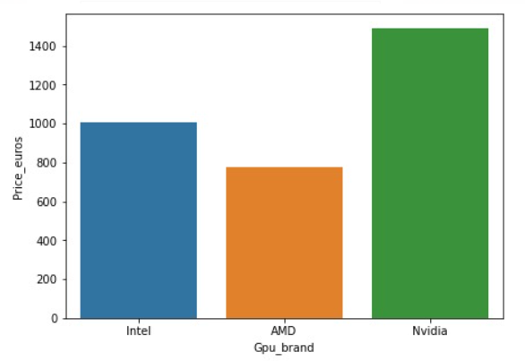
ANALYSIS ON GPU BRAND VARIABLE
Key takeaways:
Almost 55% of the laptops in the data has Intel graphic processor.
About 30% of the laptops in the data has Nvidia graphic processor.
Only 13% of the laptops in the data has AMD graphic processor.
Key takeaways:
Laptops with Nvidia graphic processor are higher priced laptops.
Laptops with Intel and AMD graphic processor are similar priced and slightly lower priced when compare to laptops with Nvidia graphic processor.

Slide 14
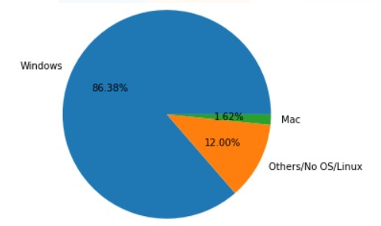
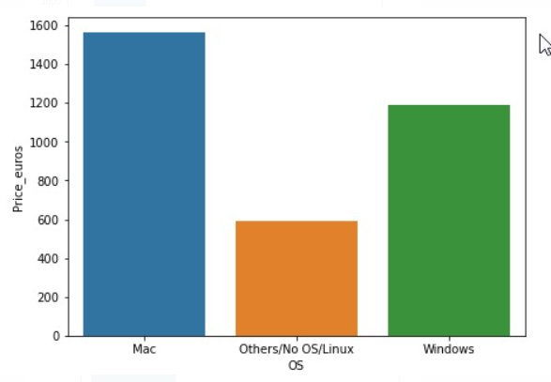
Analysis on Operating system
Key takeaways:
Almost 86% of the laptops in the given data are having Windows operating system.
Only 1% of the laptops in the data having Mac operating system.
Exactly 12% of the laptops in the data having either no operating system, Linux or other operating system.
Key takeaways:
Laptops having Mac operating system are high priced laptops.
Laptops having Windows operating system are slightly lower priced compared to Mac operating system and higher than laptops having no OS, Linux or other operating system.

Slide 15
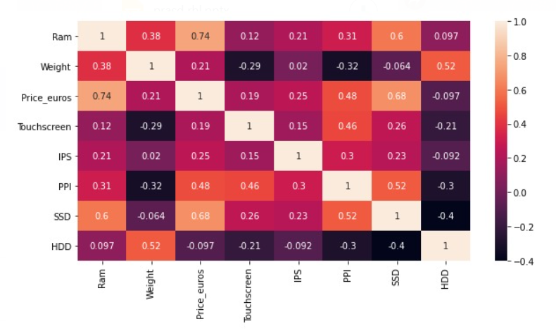
Multi collinearity matrix
VIF Table
s.no | Variables | VIF
1 | Ram | 2.21
2 | Weight | 1.83
3 | Touchscreen | 1.27
4 | IPS | 1.16
5 | PPI | 2.13
6 | SSD | 2.08
Key takeaways:
There is strong correlation among the variables RAM, SSD and Price_euros.
There is medium correlation among the variables PPI, IPS, Weight, Touchscreen and Price_euros.
There is weak correlation between the variables HDD and Price_euros.

Slide 16
Final model results
Company, TypeName, Ram, Weight, Touchscreen, IPS, PPI, Cpu_brand, SSD, Gpu_brand and OS are the significant variables that are taken into consideration.
Pruning of the Decision Tree model is done by using hyper parameters such as minimum samples for a node split and maximum depth of the tree.
Values for above mentioned Hyper parameters can be chosen by using a metric called GridsearchCV.
The training accuracy of the final model is about 92% and testing accuracy of the final model is about 85%.
The training accuracy of unpruned model is 99% and the testing accuracy of unpruned model is 84%.
The training accuracy of pruned model is 97% and the testing accuracy of pruned model is 84%.
Kind of feature engineering
Dummy variables are created as a part of the feature engineering due to the existence of lesser number of categories in the given features.
Candidate models

Slide 17
Client/End-user needs
The technical requirements that the client need to meet are Python with numpy, pandas, matplotlib, seaborn and sklearn libraries.
The files which are needed for the client are Model Data, Code file(Jupyter Notebook) and presentation report.
The client needs to drop the irrelevant features initially and then new features are derived from the features with uncleaned data.
The client can know that the model is performing well on new data points by checking the accuracy on unseen data.
Model validation
The performance of the final model are as follows:
Training model accuracy: 92.99%
Testing model accuracy: 85.05%
R2 score: 0.81
Mean Absolute Error(MAE): 1.2

Slide 18
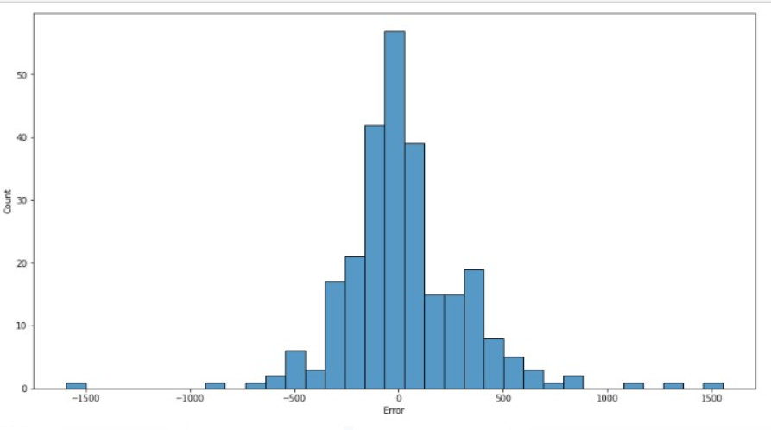
Histogram of residual deviance
Key takeaways:
The distribution for the residual deviance is a normal distribution curve which indicates that the errors are random in nature.
This shows that our model is performing well on test data.

Slide 19


Slide 20
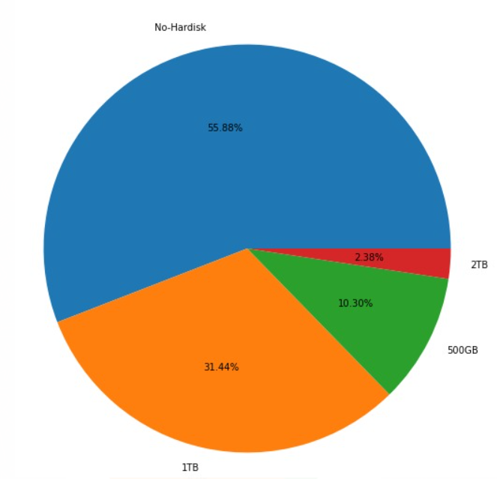
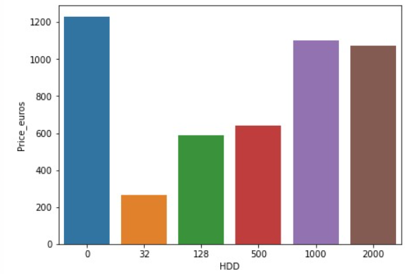
Analysis on HDD variable
Key takeaways:
About 55% of the laptops in the given data has no Hard disk drive.
About 55% of the laptops in the given data has no Hard disk drive.
Only 2% of the laptops in the given data has 2TB Hard disk drive.
Key takeaways:
Laptops having no Hard disk drive are of higher price.
Laptops with 1TB and 2TB Hard disk drive are of similar price.
Laptops with 32GB Hard disk drive are the least priced laptops in the given data.

